Slide 1
US House Price Analysis
MECE Technique

Slide 2
Components of MECE
Supply-Mutually Exclusive
Demand-Mutually Exclusive
Supply :
Completely Exhaustive : Fixed Costs ,Variable Costs , Environmental Regulation(CO2 Emissions)
Demand:
Completely Exhaustive :Population, Age, Unemployment Rates,
Interest Rates , Literacy Rates, Crime Rates, GDP per Capita , Taxes,
Migration Rates

Slide 3
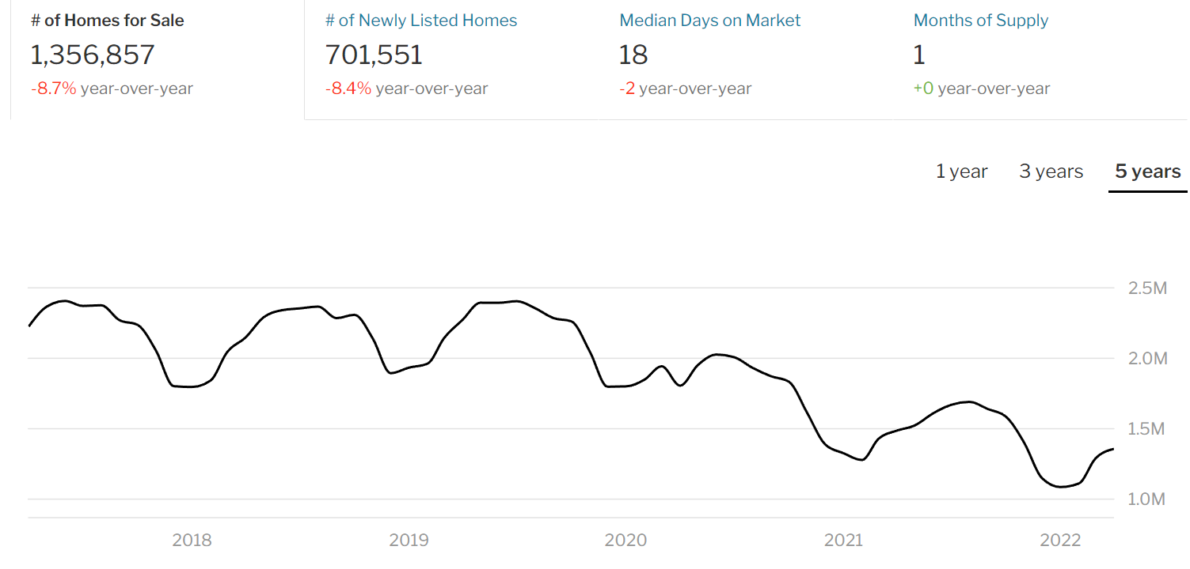
Supply –Mutually Exhaustive

Slide 4
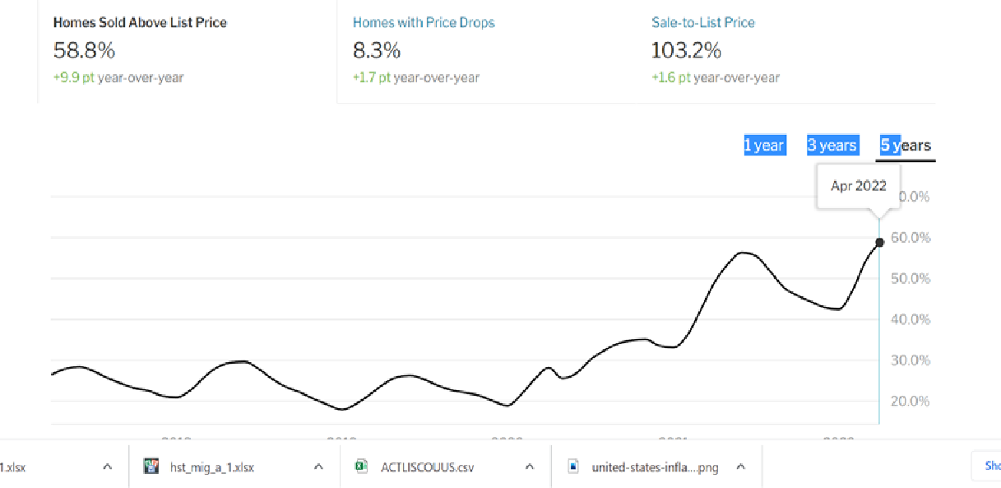
Demand- Mutually Exhaustive

Slide 5
Supply-Analysis
From the demand supply analysis we can see that the demand is has
9.9% y-o-y increase
The supply side shows that there has been -8.7% y-o-y decrease
The supply side components would include again 2 costs
Fixed Costs and Variable Costs which would include
Fixed Cost: Land acquisition cost
Please click this link:Land Price and Land Share Indicators | American Enterprise Institute - AEI
Variable Cost: Labour cost, Cost of Raw materials ,Taxes
Other Factors:Laws,Budgets

Slide 6
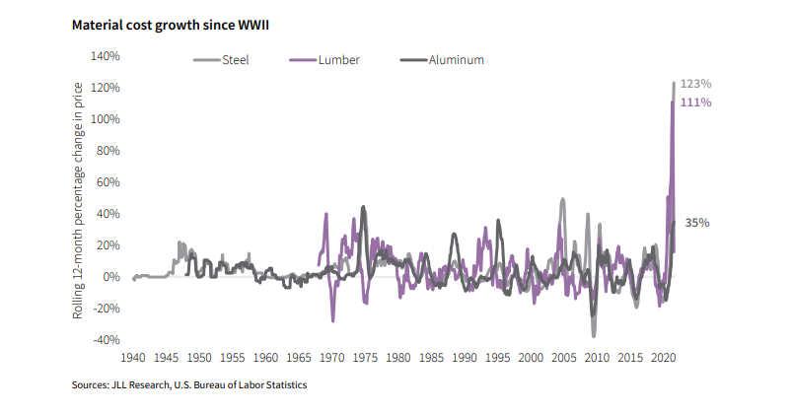
Variable Costs

Slide 7
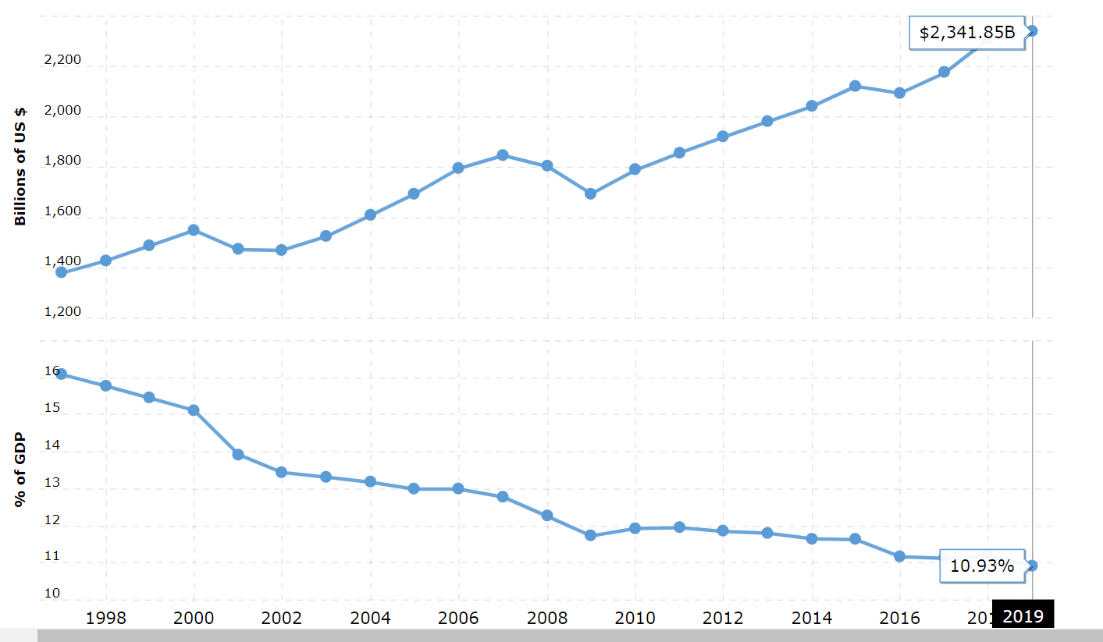
Manufacturing

Slide 8
Manufacturing
U.S. manufacturing output for 2019 was $2,341.85B, a 1.46% increase from 2018.
U.S. manufacturing output for 2018 was $2,308.06B, a 6.12% increase from 2017.
U.S. manufacturing output for 2017 was $2,174.94B, a 3.86% increase from 2016.
U.S. manufacturing output for 2016 was $2,094.07B, a 1.31% decline from 2015.

Slide 9
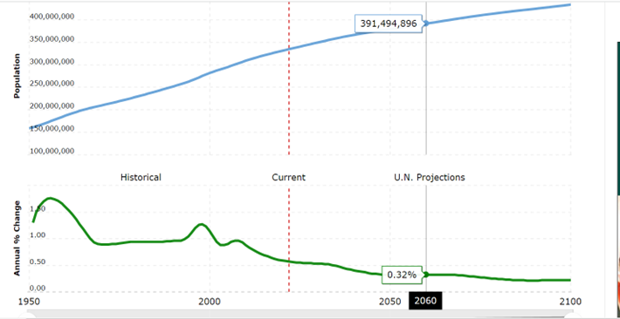
Demand Analysis-Completely Exhaustive Population

Slide 10
Demand Analysis-Completely Exhaustive Population
The current population of U.S. in 2022 is 334,805,269, a 0.57% increase from 2021.
The population of U.S. in 2021 was 332,915,073, a 0.58% increase from 2020.
The population of U.S. in 2020 was 331,002,651, a 0.59% increase from 2019.
The population of U.S. in 2019 was 329,064,917, a 0.6% increase from 2018.

Slide 11
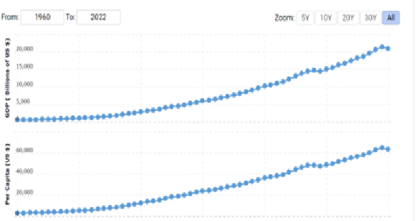
2.Economy

Slide 12
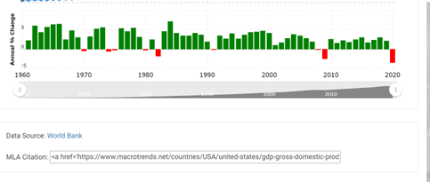
Economy

Slide 13
Economy
U.S. gdp for 2020 was $20,936.60B, a 2.32% decline from 2019.
U.S. gdp for 2019 was $21,433.22B, a 3.98% increase from 2018.
U.S. gdp for 2018 was $20,611.86B, a 5.47% increase from 2017.
U.S. gdp for 2017 was $19,542.98B, a 4.26% increase from 2016.

Slide 14
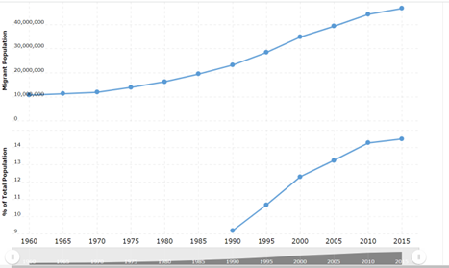
3.US Migration Data

Slide 15
4.Migration
U.S. immigration statistics for 2015 was 46,627,102.00, a 5.53% increase from 2010.
U.S. immigration statistics for 2010 was 44,183,643.00, a 12.55% increase from 2005.
U.S. immigration statistics for 2005 was 39,258,293.00, a 12.77% increase from 2000.
U.S. immigration statistics for 2000 was 34,814,053.00, a 22.36% increase from 1995.

Slide 16
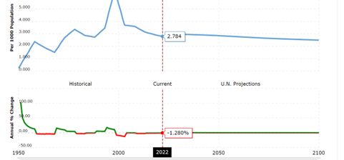
Net Migration

Slide 17
Net Migration
The current net migration rate for U.S. in 2022 is 2.784 per 1000 population, a 1.28% decline from 2021.
The net migration rate for U.S. in 2021 was 2.820 per 1000 population, a 1.3% decline from 2020.
The net migration rate for U.S. in 2020 was 2.857 per 1000 population, a 1.24% decline from 2019.
The net migration rate for U.S. in 2019 was 2.893 per 1000 population, a 1.23% decline from 2018.

Slide 18
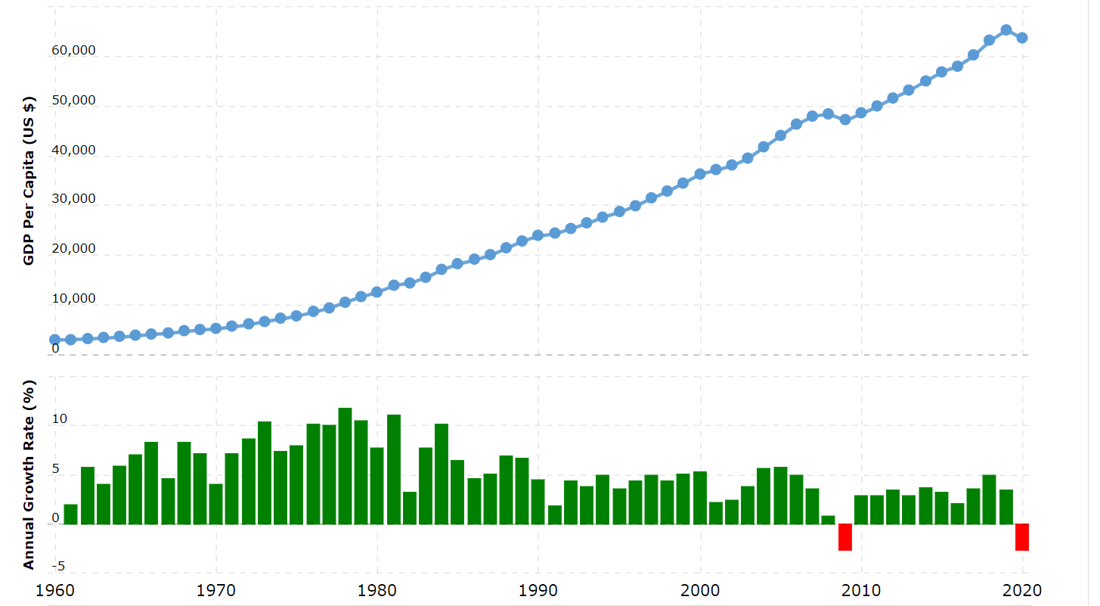
GDP Per Capita

Slide 19
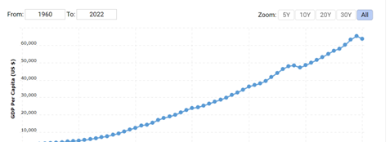
GDP Per Capita

Slide 20
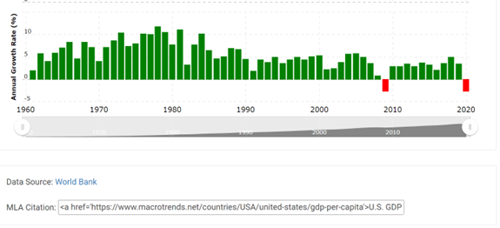
GDP Per Capita

Slide 21
GDP Per Capita
U.S. gdp per capita for 2020 was $63,544, a 2.66% decline from 2019.
U.S. gdp per capita for 2019 was $65,280, a 3.51% increase from 2018.
U.S. gdp per capita for 2018 was $63,064, a 4.92% increase from 2017.
U.S. gdp per capita for 2017 was $60,110, a 3.6% increase from 2016.

Slide 22
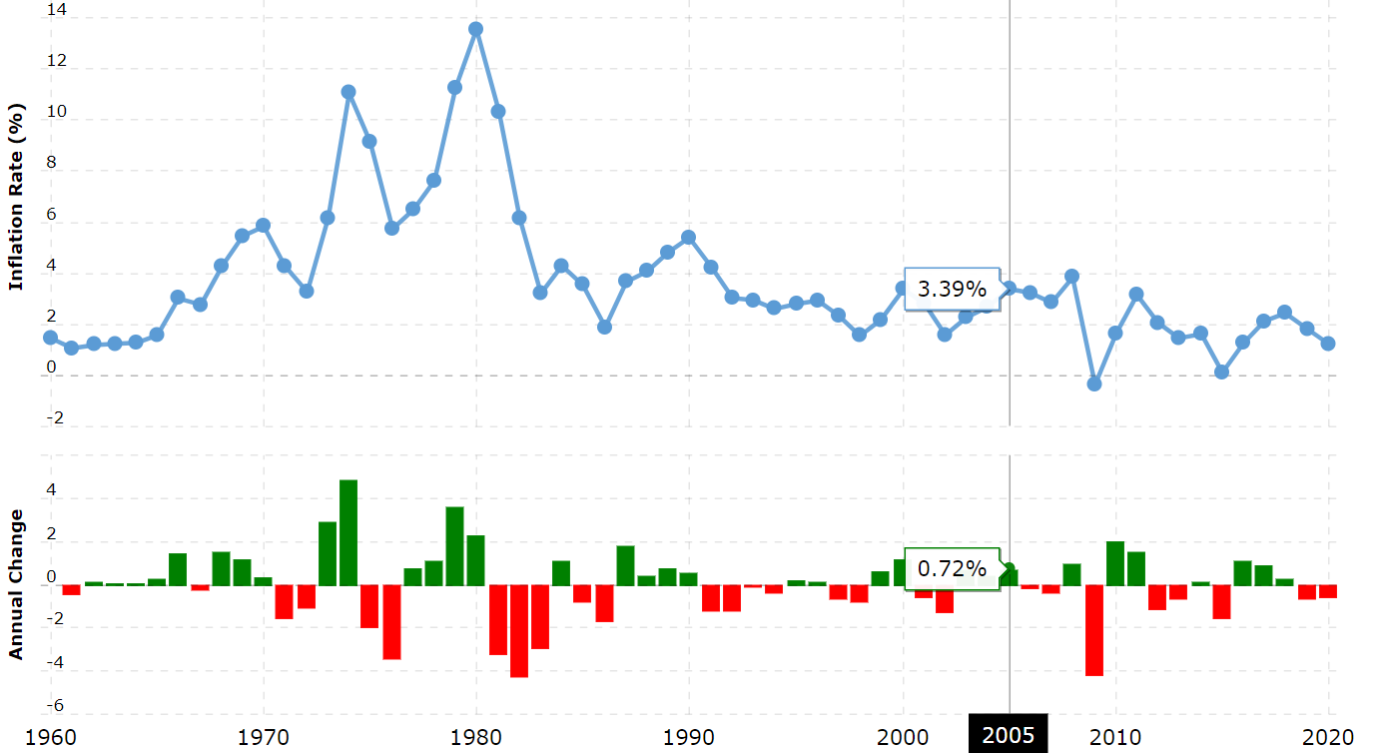
Inflation

Slide 23
Inflation
U.S. inflation rate for 2020 was 1.23%, a 0.58% decline from 2019.
U.S. inflation rate for 2019 was 1.81%, a 0.63% decline from 2018.
U.S. inflation rate for 2018 was 2.44%, a 0.31% increase from 2017.
U.S. inflation rate for 2017 was 2.13%, a 0.87% increase from 2016.

Slide 24
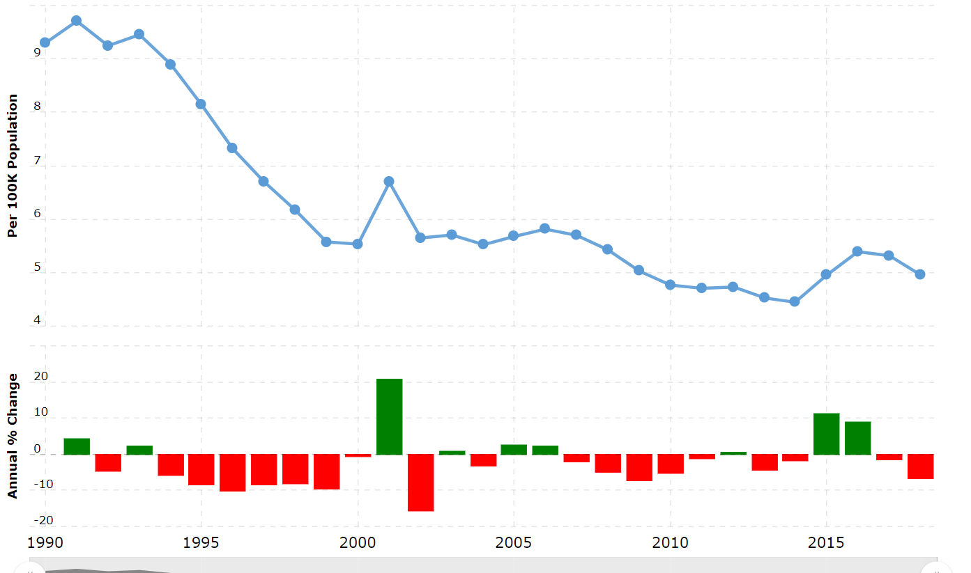
Crime

Slide 25
Crime
U.S. crime rate & statistics for 2018 was 4.96, a 6.77% decline from 2017.
U.S. crime rate & statistics for 2017 was 5.32, a 1.37% decline from 2016.
U.S. crime rate & statistics for 2016 was 5.39, a 8.91% increase from 2015.
U.S. crime rate & statistics for 2015 was 4.95, a 11.37% increase from 2014.

Slide 26
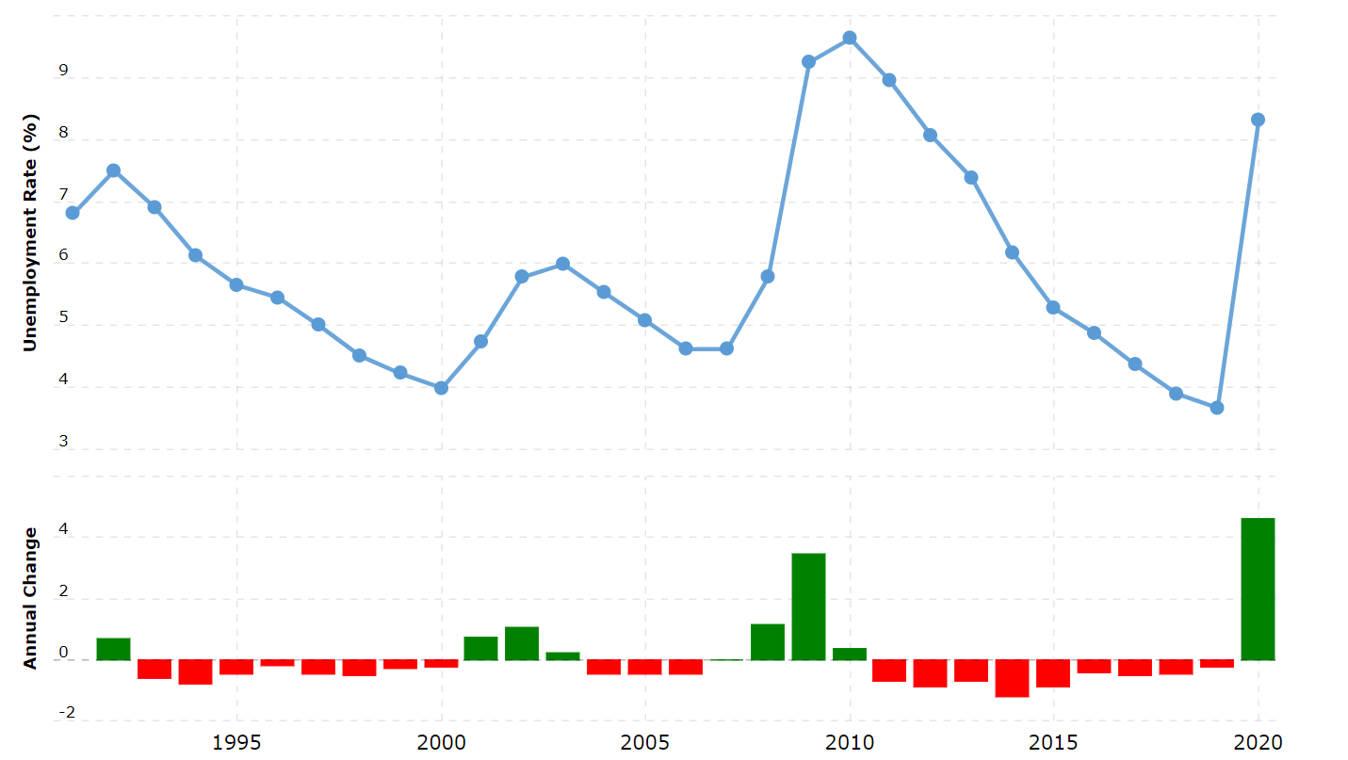
Unemployment Rate

Slide 27
Unemployment Rate
U.S. unemployment rate for 2020 was 8.31%, a 4.64% increase from 2019.
U.S. unemployment rate for 2019 was 3.67%, a 0.23% decline from 2018.
U.S. unemployment rate for 2018 was 3.90%, a 0.46% decline from 2017.
U.S. unemployment rate for 2017 was 4.36%, a 0.51% decline from 2016.

Slide 28
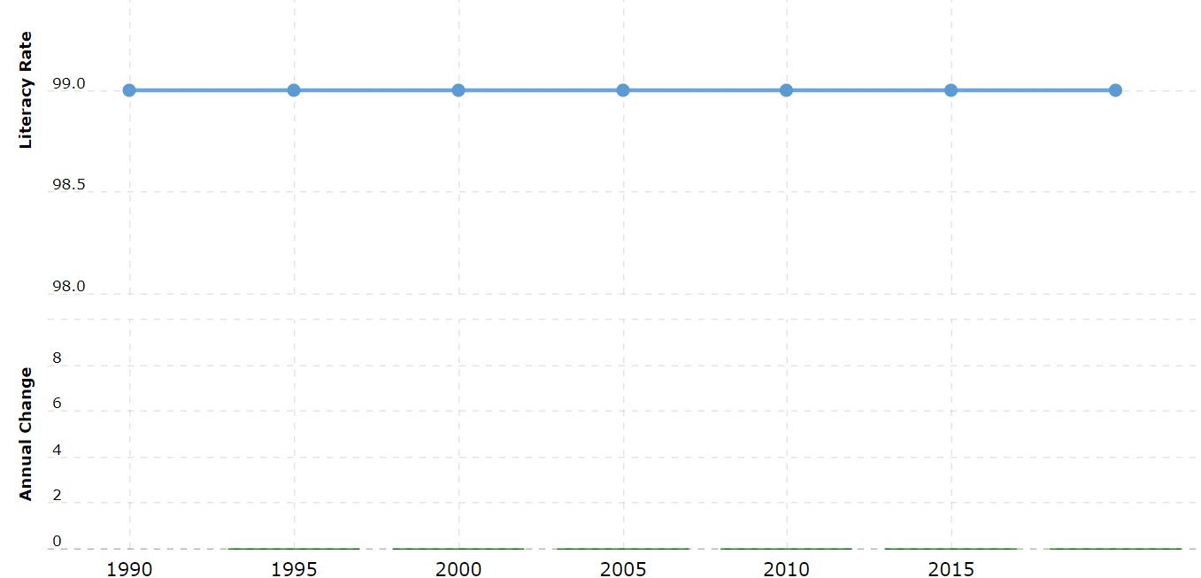
Literacy Rate

Slide 29
Literacy Rate
U.S. literacy rate for 2018 was 99.00%, a 0% increase from 2015.
U.S. literacy rate for 2015 was 99.00%, a 0% increase from 2010.
U.S. literacy rate for 2010 was 99.00%, a 0% increase from 2005.
U.S. literacy rate for 2005 was 99.00%, a 0% increase from 2000.

Slide 30
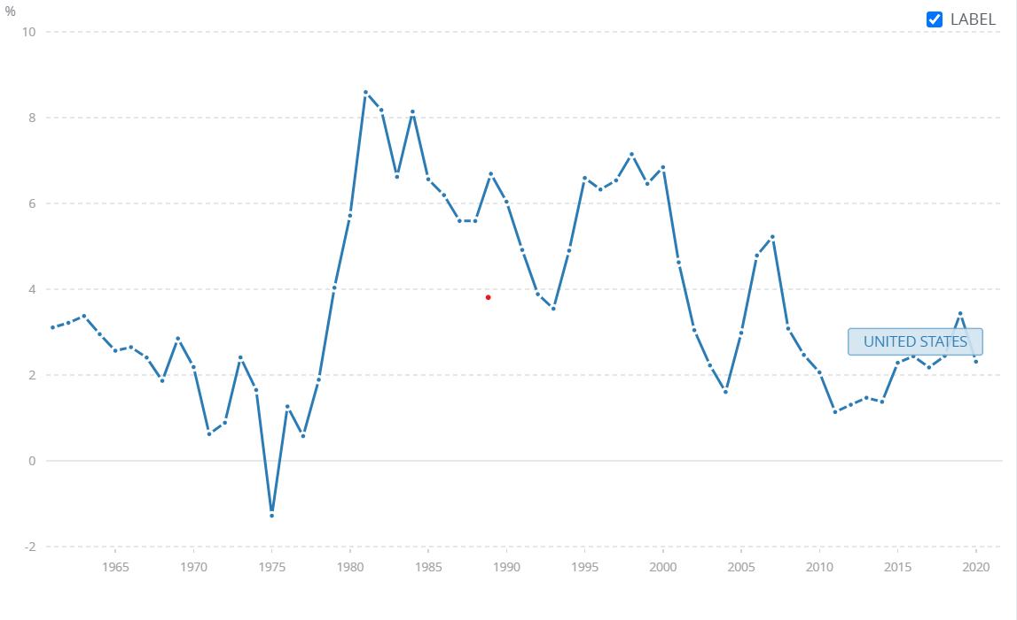
Interest Rates

Slide 31
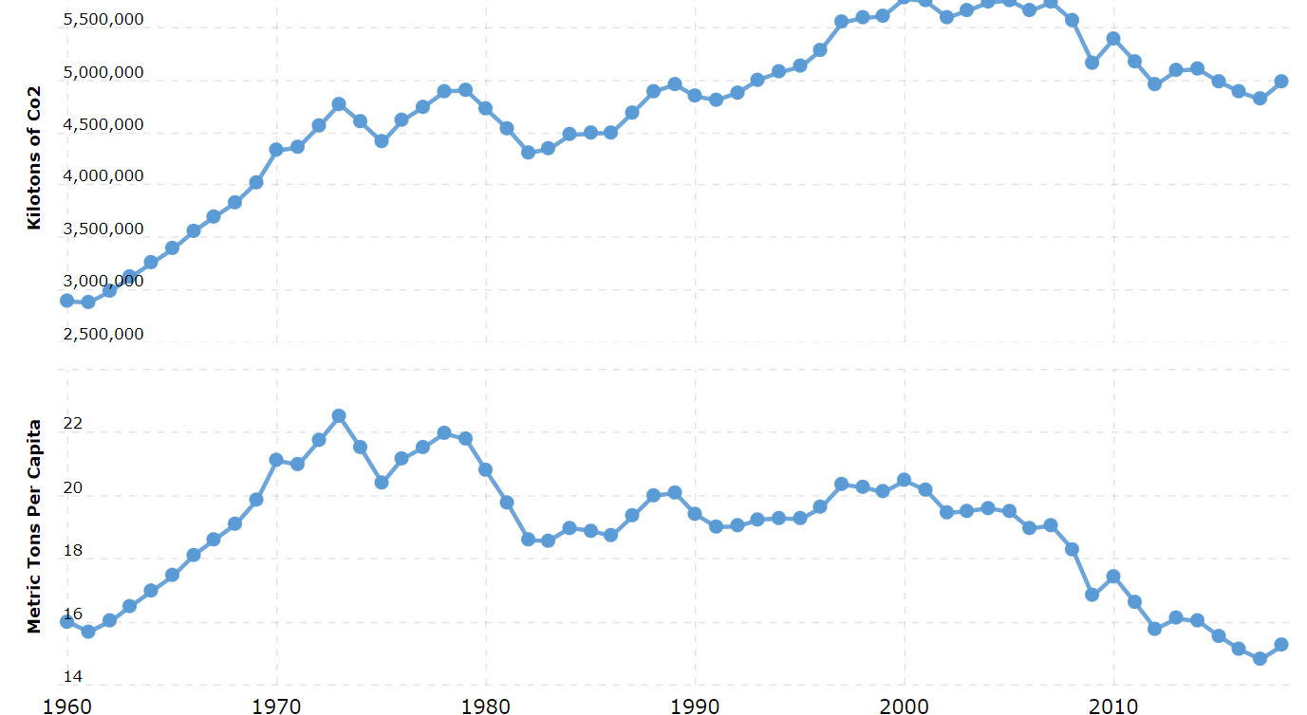
Environment-Supply Side

Slide 32
Environment-Supply
U.S. carbon (co2) emissions for 2018 was 4,981,300.00, a 3.48% increase from 2017.
U.S. carbon (co2) emissions for 2017 was 4,813,720.00, a 1.53% decline from 2016.
U.S. carbon (co2) emissions for 2016 was 4,888,640.00, a 1.89% decline from 2015.
U.S. carbon (co2) emissions for 2015 was 4,982,790.00, a 2.35% decline from 2014.
Increase in carbon could affect Raw materials used

Slide 33
Age, Taxation
Median Age-Age is helpful because we can know that once they retire they will invest in property with their savings
Median Age-38.1 yrs
Male Median Age-36.8 yrs
Female Median Age-39.4 yrs
In addition these people can invest in property

